Slide 1
CS4038
DATA MINING
LECTURE # 28
SPRING 2024
FAST – NUCES, CFD CAMPUS
AYESHA LIAQAT
ayesha.liaqat@nu.edu.pk

Slide 2
TODAY’S TOPICS
Association Rule Mining
Maximal and Closed itemsets

Slide 3
COMPACT REPRESENTATION OF FREQUENT ITEMSETS

Slide 4
COMPACT REPRESENTATION OF FREQUENT ITEMSETS
Due to large number of frequent itemsets that can be produced from transaction data, it is useful to identify a small representation of itemsets from which all other frequent itemsets can be derived.
Two approaches:
Maximal frequent itemsets
Closed frequent itemsets

Slide 5
MAXIMAL FREQUENT ITEMSETS
Definition: a frequent itemset for which none of its immediate supersets are frequent.

Slide 6
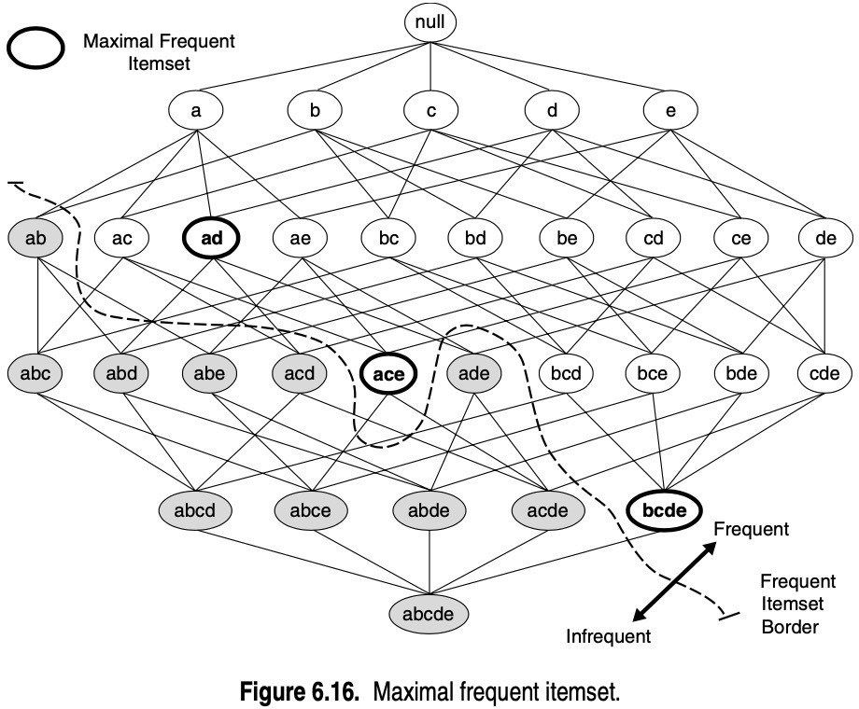
Itemsets {a,d}, {a,c,e} and {b,c,d,e} are maximal frequent itemsets because their immediate supersets are infrequent.

Slide 7
AN ILLUSTRATIVE EXAMPLE
Items
 | A | B | C | D | E | F | G | H | I | J
1
2
3
4
5
6
7
8
9
Support threshold (by count) : 5
Frequent itemsets: {F} Maximal itemsets: {F}
Support threshold (by count): 4
Frequent itemsets: ? Maximal itemsets: ?
Transactions
8

Slide 8
AN ILLUSTRATIVE EXAMPLE
 |  |  |  | Items
 | A | B | C |  | D |  | E |  | F | G | H | I | J
1
2
3
4
5
6
7
8
9
10
Support threshold (by count) : 5
Frequent itemsets: {F} Maximal itemsets: {F}
Support threshold (by count): 4
Frequent itemsets: {E}, {F}, {E,F}, {J} Maximal itemsets: {E,F}, {J}
Support threshold (by count): 3
Frequent itemsets:
All subsets of {C,D,E,F} + {J} Maximal itemsets:
{C,D,E,F}, {J}
Thus, maximal itemset form the smallest set of itemsets from which all frequent itemsets can be derived.
Transactions
10

Slide 9
SOLUTION
Items
 | A | B | C | D | E | F | G | H | I | J
1
2
3
4
5
6
7
8
9
10
Support threshold (by count) : 5
Maximal itemsets: {A}, {B}, {C}
Support threshold (by count): 4
Maximal itemsets: {A,B}, {A,C},{B,C}
Support threshold (by count): 3
Maximal itemsets: {A,B,C}
Transactions

Slide 10
CLOSED FREQUENT ITEMSETS
Closed itemsets provide a minimal representation of itemsets without losing their support information.
An itemset is a closed frequent itemset if it is closed and frequent (i.e., its support is greater than or equal to minsup).

Slide 11
CLOSED ITEMSET
An itemset X is closed if none of its immediate supersets has the same support as the itemset X.
X is not closed if at least one of its immediate supersets has support count as X.

Slide 12
CLOSED ITEMSET
An itemset X is closed if none of its immediate supersets has the same support as the itemset X.
X is not closed if at least one of its immediate supersets has support count as X.
Itemset | Support
{A} | 4
{B} | 5
{C} | 3
{D} | 4
{A,B} | 4
{A,C} | 2
{A,D} | 3
{B,C} | 3
{B,D} | 4
{C,D} | 3
TID | Items
1 | {A,B}
2 | {B,C,D}
3 | {A,B,C,D}
4 | {A,B,D}
5 | {A,B,C,D}
Itemset | Support
{A,B,C} | 2
{A,B,D} | 3
{A,C,D} | 2
{B,C,D} | 2
{A,B,C,D} | 2
Which of these itemsets are closed?

Slide 13
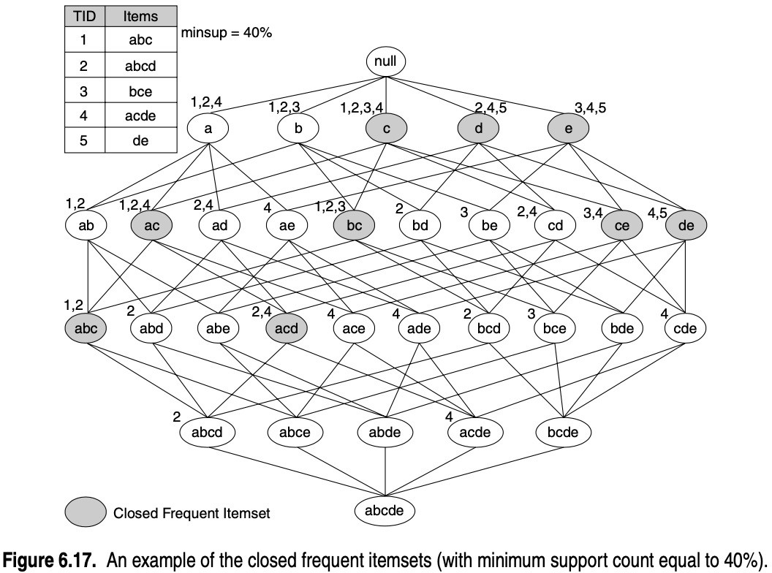
Closed frequent itemsets are useful for removing some of the redundant association rules.
An association rule X → Y is redundant if there exists another rule X′ →Y′, where X is a subset of X′ and Y is a subset of Y′, such that the support and confidence for both rules are identical.
{b} is not a closed frequent itemset while {b, c} is closed.The association rule {b} → {d,e} is therefore redundant because it has the same support and confidence as {b,c} → {d,e}.
Such redundant rules can be skipped if closed frequent itemsets are used for rule generation.

Slide 14
CLOSED FREQUENT ITEMSET
Consider the frequent itemset {a,d}.
Since it is not closed, its support count must be equal to one of its immediate supersets: {a,b,d}, {a,c,d} or {a,d,e}
The key is to determine such superset.
According to Apriori principle:
Any transaction that contains the superset of {a,d} must also contain {a,d}.
However, any transaction that contains {a,d} does not have to contain the supersets of {a,d].
Thus, support for {a,d} must be equal to the largest support among its supersets (which is
{a,c,d} here).
This approach can be used to compute support for the non-closed frequent itemsets.

Slide 15
WHAT ARE THE CLOSED ITEMSETS IN THIS DATA?
TID | A1 | A2 | A3 | A4 | A5 | A6 | A7 | A8 | A9 | A10 | B1 | B2 | B3 | B4 | B5 | B6 | B7 | B8 | B9 | B10 | C1 | C2 | C3 | C4 | C5 | C6 | C7 | C8 | C9 | C10
1 | 1 | 1 | 1 | 1 | 1 | 1 | 1 | 1 | 1 | 1 | 0 | 0 | 0 | 0 | 0 | 0 | 0 | 0 | 0 | 0 | 0 | 0 | 0 | 0 | 0 | 0 | 0 | 0 | 0 | 0
2 | 1 | 1 | 1 | 1 | 1 | 1 | 1 | 1 | 1 | 1 | 0 | 0 | 0 | 0 | 0 | 0 | 0 | 0 | 0 | 0 | 0 | 0 | 0 | 0 | 0 | 0 | 0 | 0 | 0 | 0
3 | 1 | 1 | 1 | 1 | 1 | 1 | 1 | 1 | 1 | 1 | 0 | 0 | 0 | 0 | 0 | 0 | 0 | 0 | 0 | 0 | 0 | 0 | 0 | 0 | 0 | 0 | 0 | 0 | 0 | 0
4 | 1 | 1 | 1 | 1 | 1 | 1 | 1 | 1 | 1 | 1 | 0 | 0 | 0 | 0 | 0 | 0 | 0 | 0 | 0 | 0 | 0 | 0 | 0 | 0 | 0 | 0 | 0 | 0 | 0 | 0
5 | 1 | 1 | 1 | 1 | 1 | 1 | 1 | 1 | 1 | 1 | 0 | 0 | 0 | 0 | 0 | 0 | 0 | 0 | 0 | 0 | 0 | 0 | 0 | 0 | 0 | 0 | 0 | 0 | 0 | 0
6 | 0 | 0 | 0 | 0 | 0 | 0 | 0 | 0 | 0 | 0 | 1 | 1 | 1 | 1 | 1 | 1 | 1 | 1 | 1 | 1 | 0 | 0 | 0 | 0 | 0 | 0 | 0 | 0 | 0 | 0
7 | 0 | 0 | 0 | 0 | 0 | 0 | 0 | 0 | 0 | 0 | 1 | 1 | 1 | 1 | 1 | 1 | 1 | 1 | 1 | 1 | 0 | 0 | 0 | 0 | 0 | 0 | 0 | 0 | 0 | 0
8 | 0 | 0 | 0 | 0 | 0 | 0 | 0 | 0 | 0 | 0 | 1 | 1 | 1 | 1 | 1 | 1 | 1 | 1 | 1 | 1 | 0 | 0 | 0 | 0 | 0 | 0 | 0 | 0 | 0 | 0
9 | 0 | 0 | 0 | 0 | 0 | 0 | 0 | 0 | 0 | 0 | 1 | 1 | 1 | 1 | 1 | 1 | 1 | 1 | 1 | 1 | 0 | 0 | 0 | 0 | 0 | 0 | 0 | 0 | 0 | 0
10 | 0 | 0 | 0 | 0 | 0 | 0 | 0 | 0 | 0 | 0 | 1 | 1 | 1 | 1 | 1 | 1 | 1 | 1 | 1 | 1 | 0 | 0 | 0 | 0 | 0 | 0 | 0 | 0 | 0 | 0
11 | 0 | 0 | 0 | 0 | 0 | 0 | 0 | 0 | 0 | 0 | 0 | 0 | 0 | 0 | 0 | 0 | 0 | 0 | 0 | 0 | 1 | 1 | 1 | 1 | 1 | 1 | 1 | 1 | 1 | 1
12 | 0 | 0 | 0 | 0 | 0 | 0 | 0 | 0 | 0 | 0 | 0 | 0 | 0 | 0 | 0 | 0 | 0 | 0 | 0 | 0 | 1 | 1 | 1 | 1 | 1 | 1 | 1 | 1 | 1 | 1
13 | 0 | 0 | 0 | 0 | 0 | 0 | 0 | 0 | 0 | 0 | 0 | 0 | 0 | 0 | 0 | 0 | 0 | 0 | 0 | 0 | 1 | 1 | 1 | 1 | 1 | 1 | 1 | 1 | 1 | 1
14 | 0 | 0 | 0 | 0 | 0 | 0 | 0 | 0 | 0 | 0 | 0 | 0 | 0 | 0 | 0 | 0 | 0 | 0 | 0 | 0 | 1 | 1 | 1 | 1 | 1 | 1 | 1 | 1 | 1 | 1
15 | 0 | 0 | 0 | 0 | 0 | 0 | 0 | 0 | 0 | 0 | 0 | 0 | 0 | 0 | 0 | 0 | 0 | 0 | 0 | 0 | 1 | 1 | 1 | 1 | 1 | 1 | 1 | 1 | 1 | 1
(A1-A10)
(B1-B10)
(C1-C10)

Slide 16
EXAMPLE 1
Items
 | A | B | C | D | E | F | G | H | I | J
1
2
3
4
5
6
7
8
9
10
Itemsets | Support (counts) | Closed itemsets
{C} | 3 | ✓
Transactions
{D} 2
{C,D} 2 ✓
20

Slide 17
EXAMPLE 2 Items
 | A | B | C | D | E | F | G | H | I | J
1
2
3
4
5
6
7
8
9
10
Itemsets | Support (counts) | Closed itemsets
{C} | 3 | ✓
Transactions
{D} 2
{E} 2
{C,D} 2
{C,E} 2
{D,E} 2
{C,D,E} 2 ✓
22

Slide 18
MAXIMAL VS CLOSED ITEMSETS
null
Transaction Ids
124
A
123
B
1234
245
345
TID | Items
1 | ABC
2 | ABCD
3 | BCE
4 | ACDE
5 | DE
C
D
E
12
AB
124
AC
24
AD
4
123
2
3
24
34
45
AE
BC
BD
BE
CD
CE
DE
12
2
24
4
4
2
3
4
ABC
ABD
ABE
ACD
ACE
ADE
BCD
BCE
BDE
CDE
2
4
ABCD
ABCE
ABDE
ACDE
BCDE
Not supported by any transactions
ABCDE

Slide 19
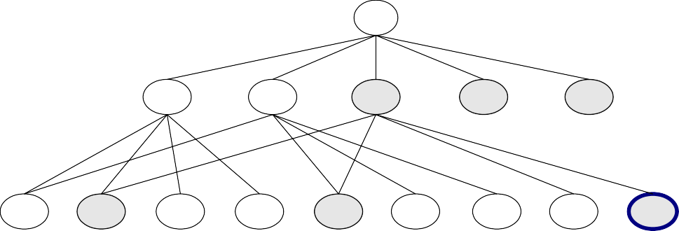

MAXIMAL FREQUENT VS CLOSED FREQUENT ITEMSETS
null
Closed but not maximal
124
A
123
B
1234
C
245
345
Minimum support = 2
D
E
Closed and maximal
TID | Items
1 | ABC
2 | ABCD
3 | BCE
4 | ACDE
5 | DE
12
AB
124
AC
24
AD
4
123
2
3
24
34
45
AE
BC
BD
BE
CD
CE
DE
12
2
24
4
4
2
3
4
ABC
ABD
ABE
ACD
ACE
ADE
BCD
BCE
BDE
CDE
2
ABCD
4
ACDE
# Closed frequent = 9
# Maximal frequent = 4
ABCE
ABDE
BCDE
ABCDE

Slide 20
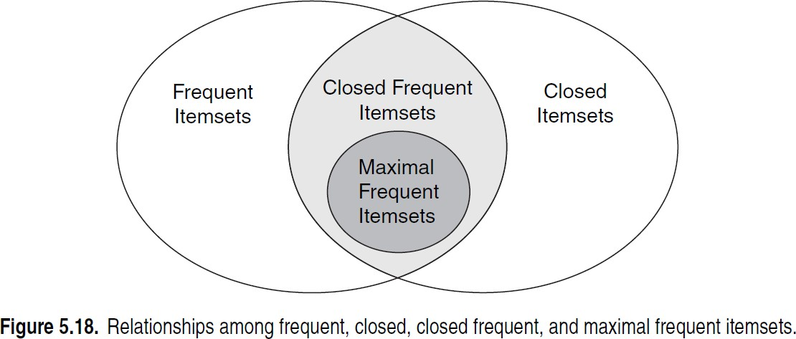
MAXIMAL VS CLOSED ITEMSETS

Slide 21
REFERENCES
Chapter 6:Tan, Steinbach & Kumar
Chapter 6: Han, Kamber & Pei
30

